Slide 1

Linux Basics ( course VII )
I am
root!
Florentiu Ilie

Slide 2
Course Content
Course1: Startup and Shutdown +
Course2: Linux directory tree, SSH
Course3: File permissions, Environment variables +
Course4: Users, Groups, Jobs +
Course5: Processes, Logging, Archiving
Course6: Disk Partitioning, Filesystems
Course7: LVM
Course8: Backup, Useful commands
Course9: Networking
Course10: Basic Troubleshooting

Slide 3
Schedule
Initialization Test (20m)
Course 1-2(1h each)
Test 2 (20m)
Course 3-5
Test 3 (50m)
Course 6-7
Test 4 (30m)
Project ( 7days)
Project presentation (1h each student)
Course 8-10
Test 5 (20m)
Review of all courses 1-10 (1-2h)
Final Test 1 – theoretical (1h)
Final Test 2 – practical (1-2h)

Slide 4
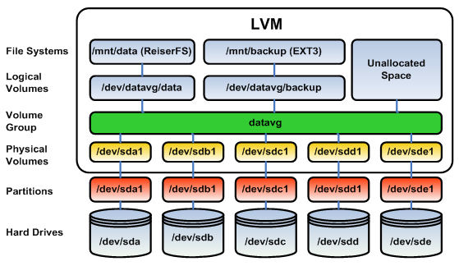
LVM
LVM = Logical Volume Manager
The LVM solution is widely used for managing disk storage. LVM enables you to accumulate spaces taken from one or several disks (called physical volumes) to form a large logical container (called, volume group), which can then be divided into partitions (called logical volumes).

Slide 5
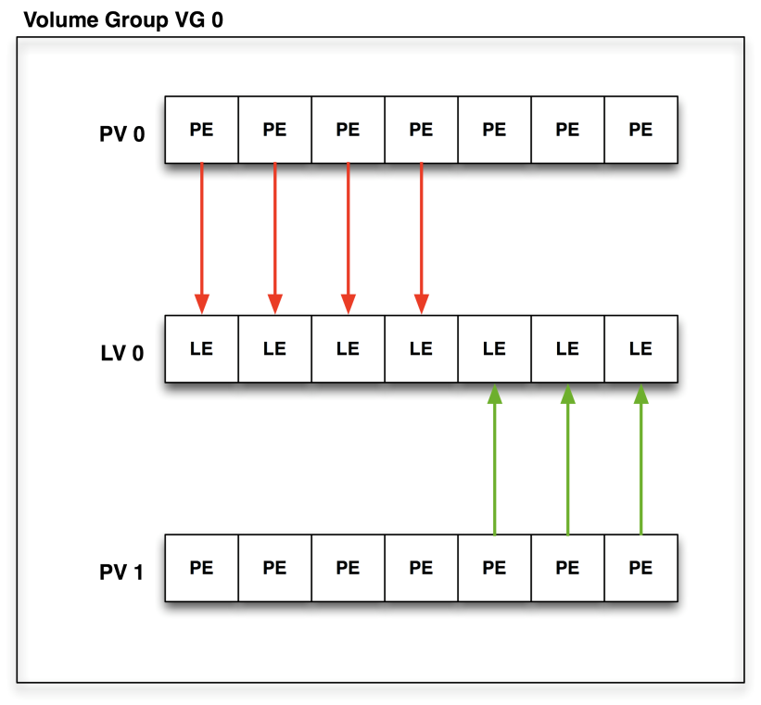
LVM
When a volume group is created, the physical volume added to it is divided into several smaller logical pieces calles PHYSICAL EXTENTS (PE).
An extent is the smallest allocatable unit of space in LVM.
At volume group creation time, you can either define the size of the PE or leave it to the default value which is 4MB. ( 8Gb = 2000PEs )
A logical volume is made up of extents called LOGICAL EXTENTS (LE). LOGICAL EXTENTS point to PHYSICAL EXTENTS, just like in the following picture:

Slide 6
LVM
Useful commands:
Command | Description
Lvcreate | Creates a logical volume
Lvdisplay | Displays details of a logical volume
Lvextend | Extends a logical volume
Lvreduce | Reduces a logical volume
Lvremove | Remove a logical volume
Lvrename | Renames a logical volume
Pvcreate | Initializes a disk or partition for LVM
Pvdisplay | Displays details of a physical volume
Pvmove | Moves data from one PV to another
Pvremove | Uninitializes a physical volume
Vgcreate | Creates a volume group
Vgdisplay | Displays details of a volume group
Vgextend | Extends a volume group
Vgremove | Removes a volume group

Slide 7
LVM
The way lvm, partitions and filesystem are stacked up together:
1) Physically / virtually add a disk to the server
2) Fdisk /dev/sdXX - format the disk with fdisk command
3) Creating physical devices: PVCREATE /dev/sdXX
4) Creating volume groups: VGCREATE vg_NAME /dev/sdXX
5) Creating logical volumes: lvcreate –L 100M –n lv_NAME vg_NAME
6) mkfs.xfs /dev/vg_NAME/lv_NAME - create a filesystem on top of the lvm you have created
7) mount /dev/vg_NAME/lv_NAME /name_directory - mount the filesystem into a directory
8) vi /etc/fstab – edit /etc/fstab to make the mount available at reboot

Slide 8

Questions ?

